Slide 1
Predicting Credit Defaults Using Imbalanced Data Techniques
Alex Ojemann and Dehkontee Chea Cuppah

Slide 2
Introduction
For many banks, retaining high profitable customers is the number one business goal. Banking fraud, however, poses a significant threat to this goal for different banks. In terms of substantial financial losses, trust and credibility, this is a concerning issue to both banks and customers alike.
It has been estimated by a Nilson report that by 2025 the banking frauds would account to approximately $50 billion worldwide. With the rise in digital payment channels, the number of fraudulent transactions is also increasing with new and different ways.
In the banking industry, credit card fraud detection using machine learning is not just a trend but a necessity for them to put proactive monitoring and fraud prevention mechanisms in place. Machine learning is helping these institutions to reduce time-consuming manual reviews, costly chargebacks and fees, and denials of legitimate transactions.

Slide 3
Dataset Structure
The dataset was retrieved from an open-source website, Kaggle.com. it contains data of transactions that were made in 2013 by credit card users in Europe.
The dataset contains:
Rows: The dataset contains 65,535 entries.
Columns: There are 122 columns, featuring a mix of numeric and categorical data. Some key columns are:
SK_ID_CURR: Unique identifier for each application or customer.
TARGET: Whether the customer defaulted (1 = defaulted, 0 = not defaulted).
AMT_INCOME_TOTAL: Total income of the applicant.
AMT_CREDIT: Total credit amount used by the customer.
EXTERNAL SOURCES: Features like EXT_SOURCE_1, EXT_SOURCE_2, and EXT_SOURCE_3 might represent external credit risk factors or scores.
Some behavioral features, like DAYS_EMPLOYED, AMT_CREDIT, or EXT_SOURCE_1, was analyzed to understand financial behavior, which will inform certain elements of fraudulent applications or credit misuse.

Slide 4
ANALYSIS
Predictive Modeling: The target column (TARGET) was identified to be used for binary classification tasks to predict whether an customer is doing fraud or not..
Feature Engineering: the goal of us using feature engineering is to enhance the predictive power of or model by transforming raw data into formats or representations that better reveal the underlying patterns or relationships. Categorical columns (like NAME_CONTRACT_TYPE, CODE_GENDER) need encoding, while numerical columns might require normalization/scaling.
Data Preprocessing: Handle missing values, identify correlations, and clean data before applying any machine learning models.

Slide 5
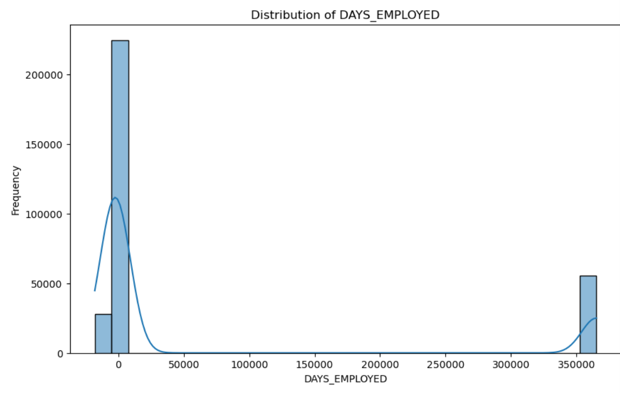
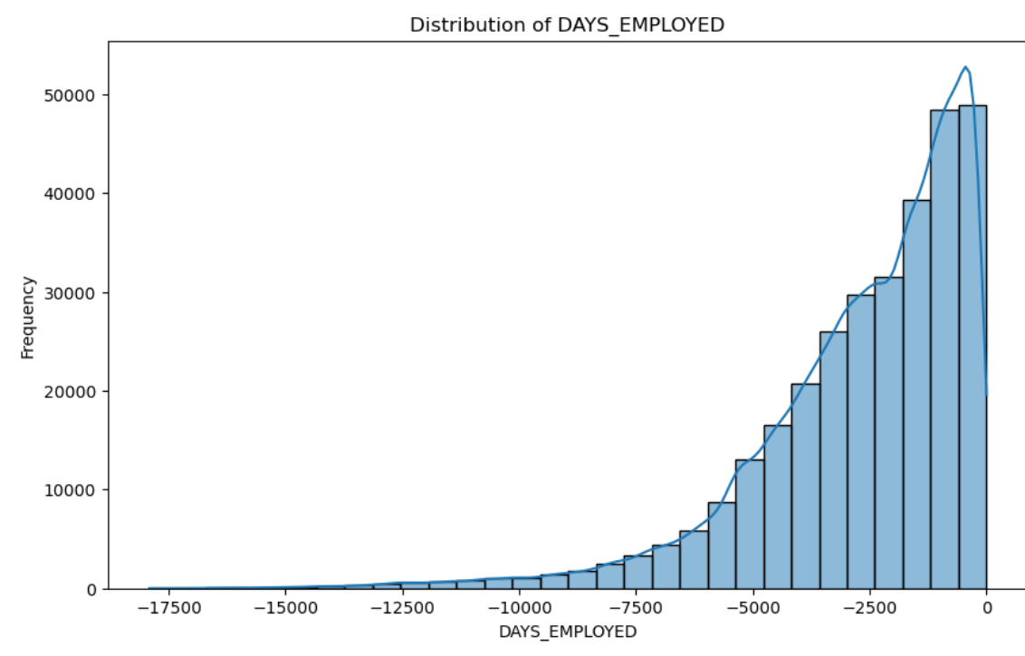
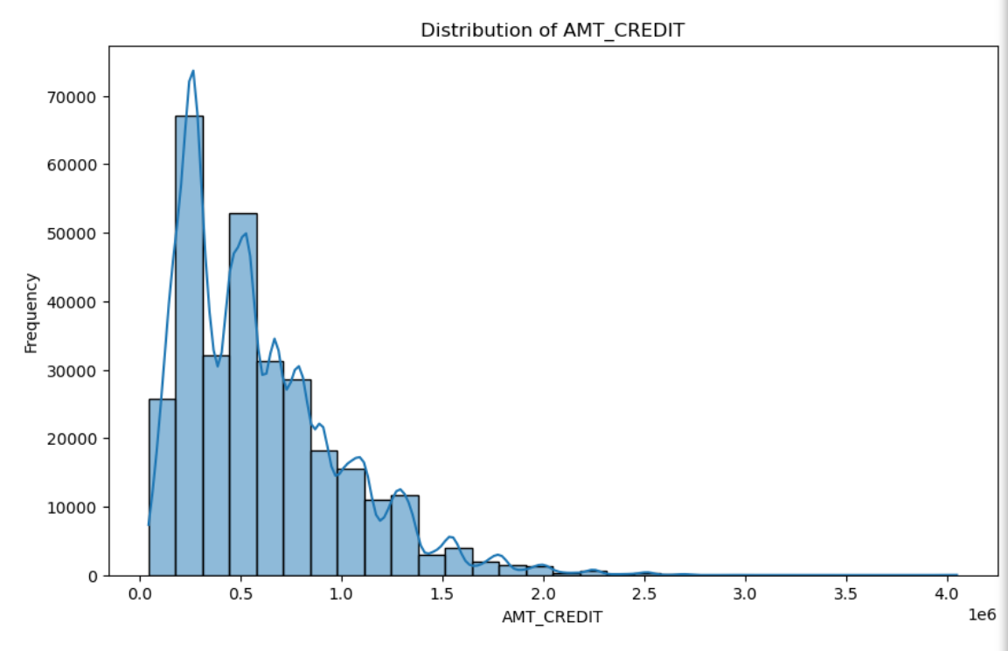
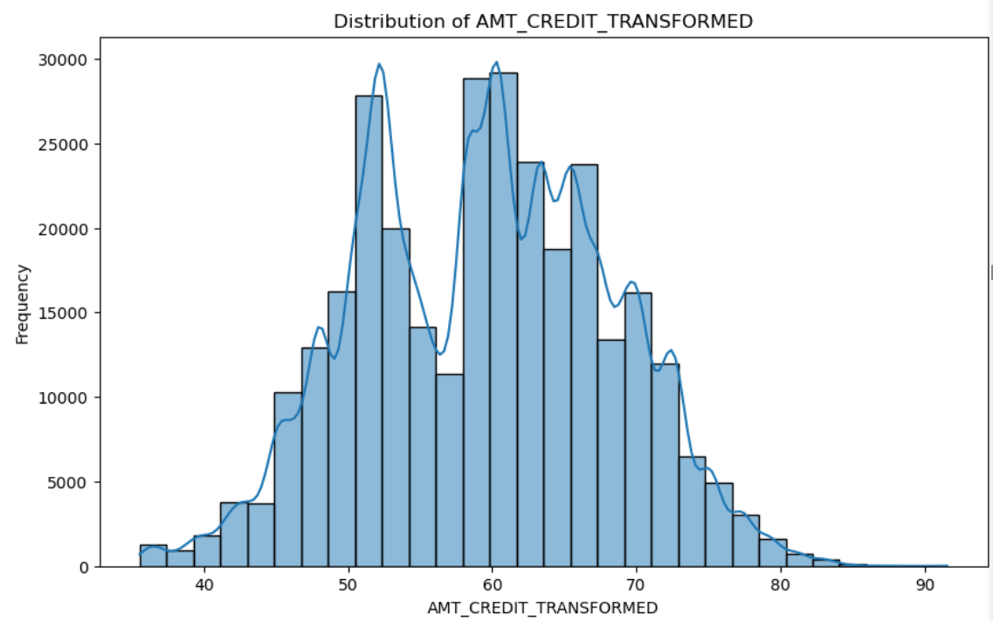
Feature Engineering
Before
After
KNN Imputation
Box-Cox Transformation

Slide 6
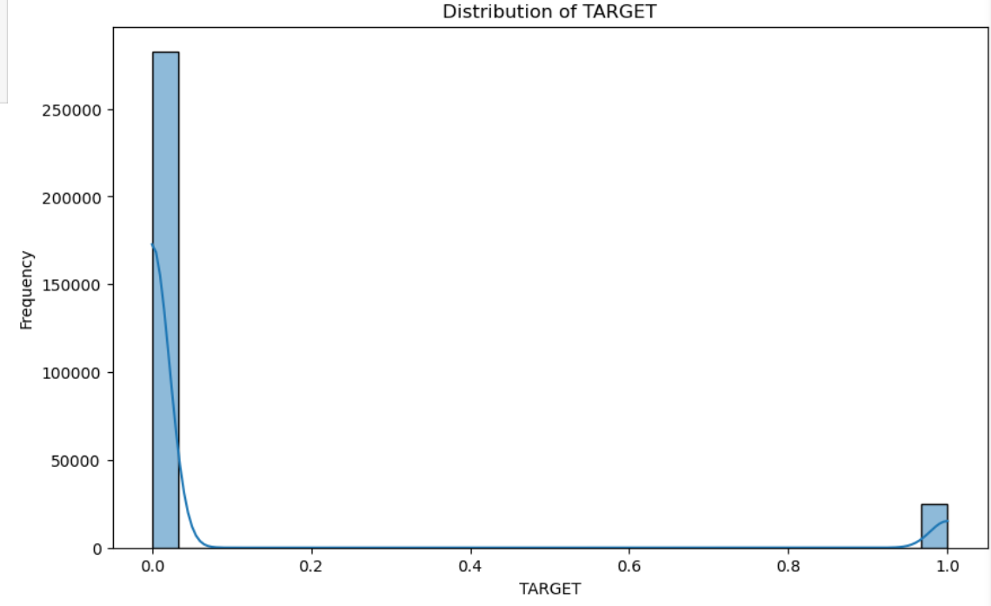
Imbalanced Classes

Slide 7
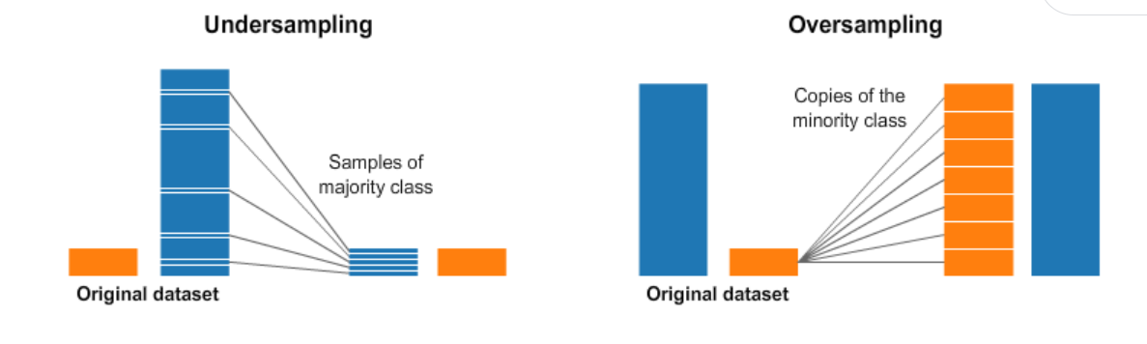
Undersampling/Oversampling

Slide 8
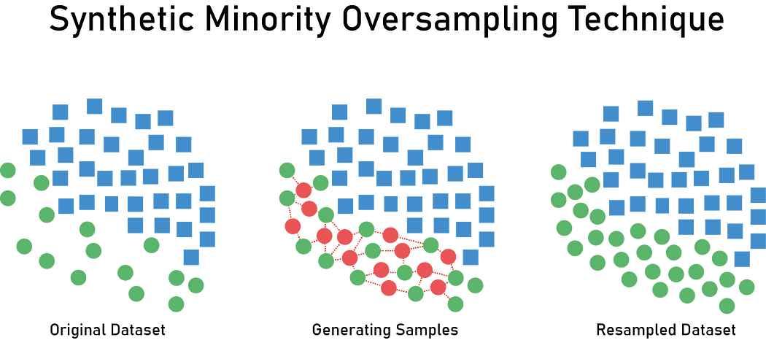
SMOTE

Slide 9
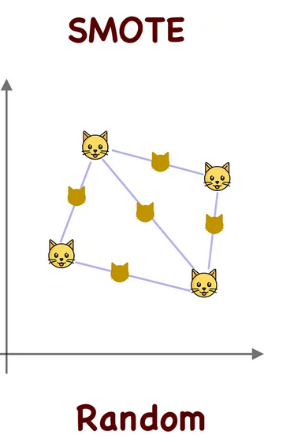
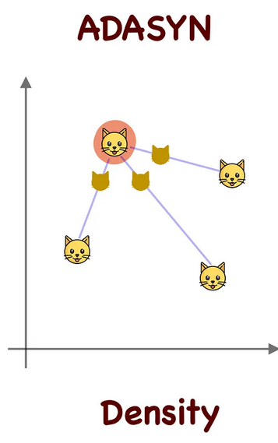
ADASYN

Slide 10
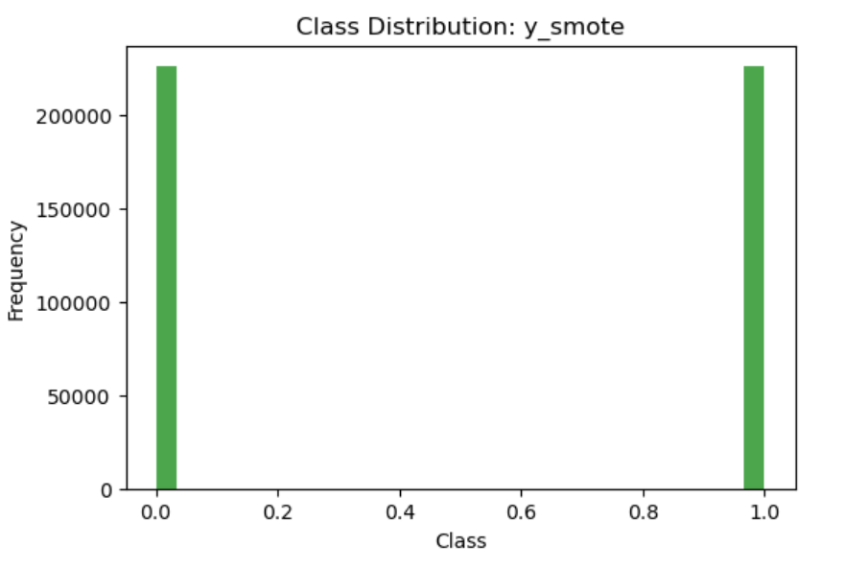
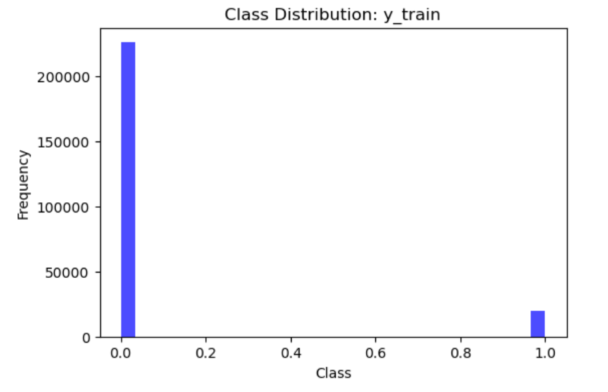
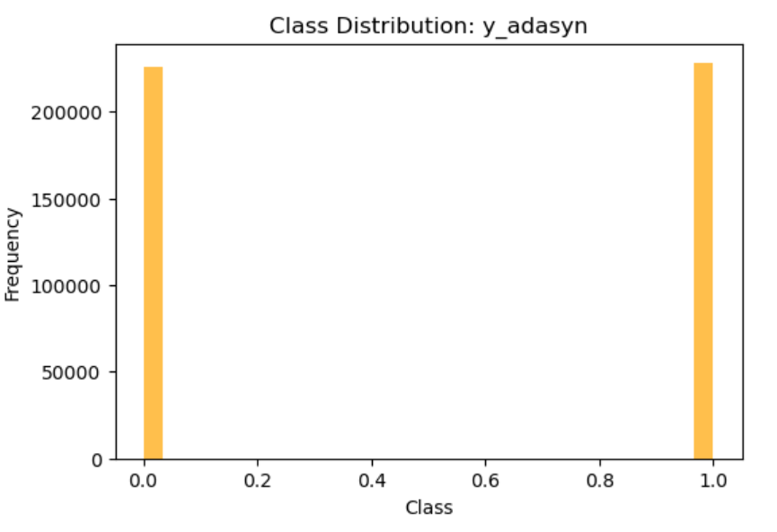
Class Balance

Slide 11
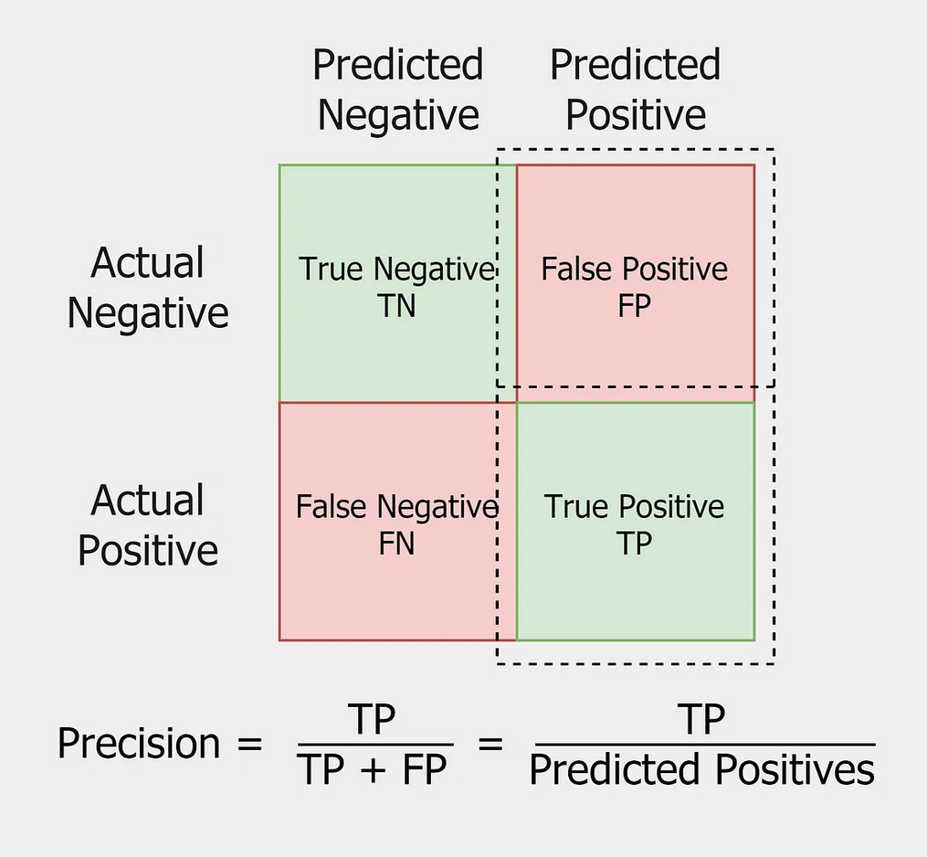
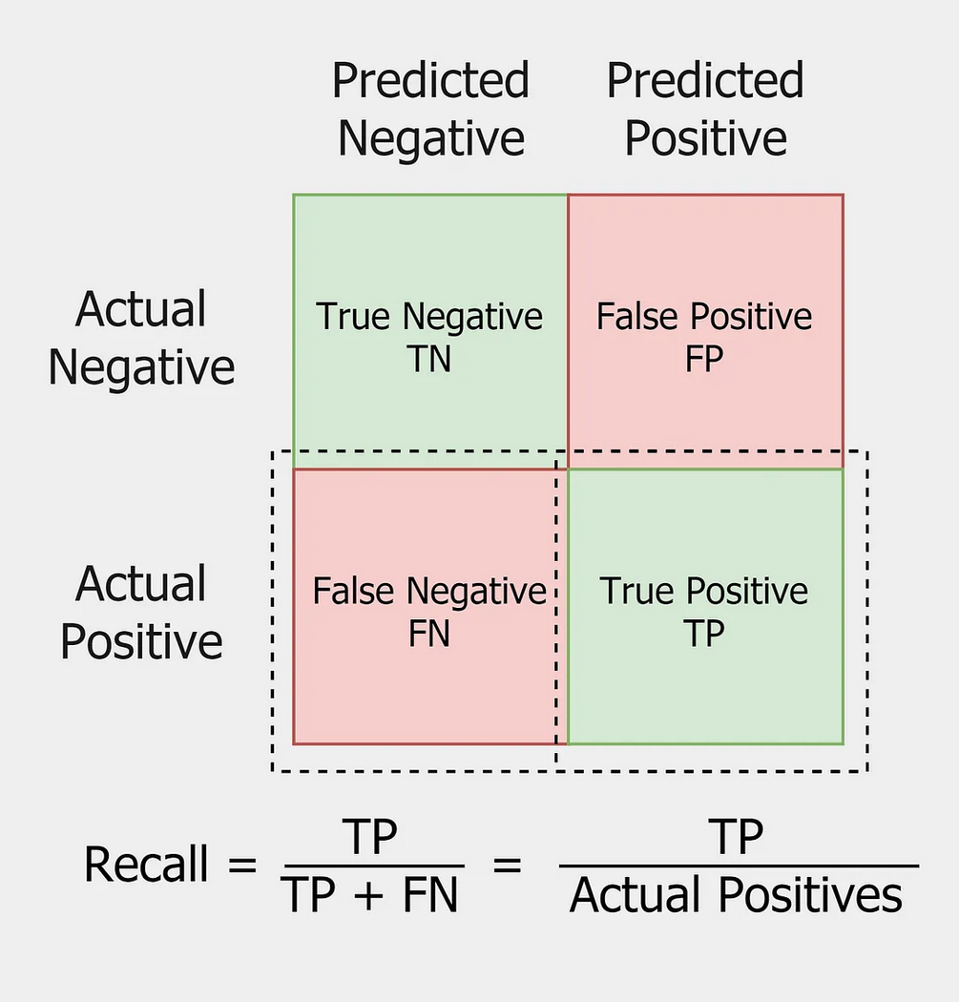
Evaluation Metrics

Slide 12
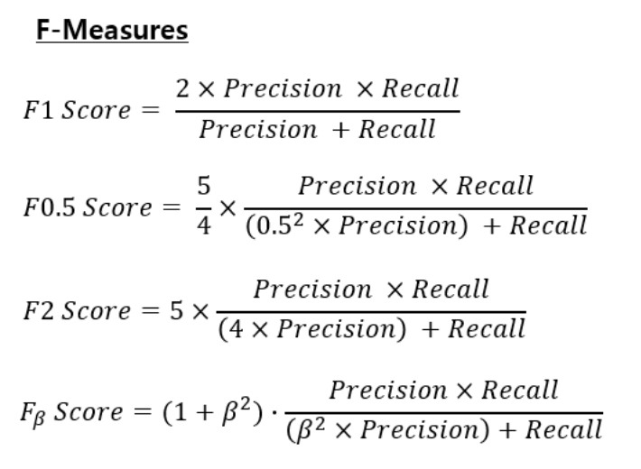
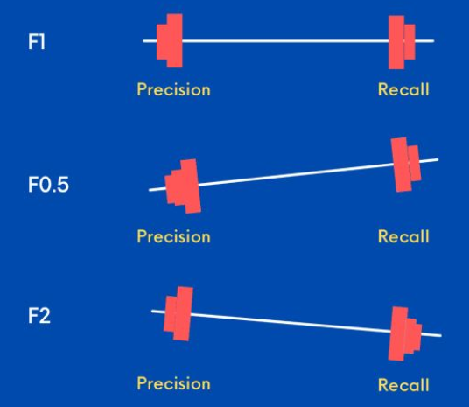
Evaluation Metrics

Slide 13

Models
KNN, Logistic Regression, Naive Bayes, Decision Tree, Random Forest, AdaBoost, and XGBoost
All models trained on original data, SMOTE data and ADASYN data for comparison, but only tested on unaltered test set (20% of original data using a stratified train test split)
Hyperparameter tuning was initially attempted using grid search, but could only test a limited number of combinations due to dataset size even with only 15% of the samples being used in training. This reduction in training samples resulted in relatively poor performance so default hyperparameters were used and the entire dataset was used for training.

Slide 14
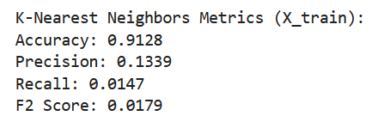
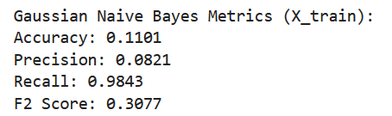
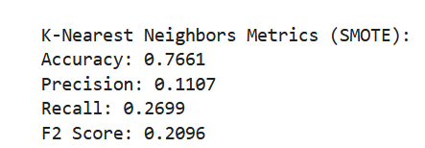
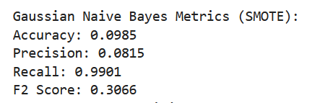
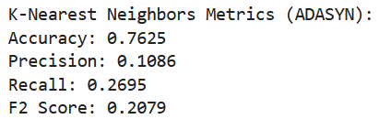
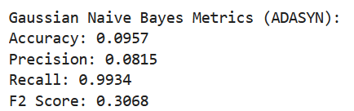
Results

Slide 15
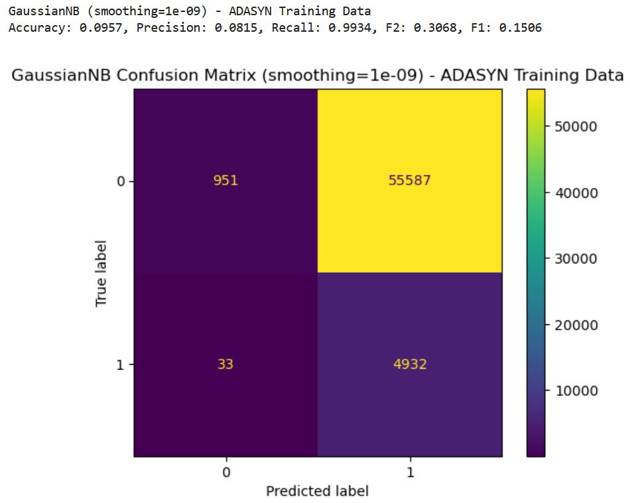
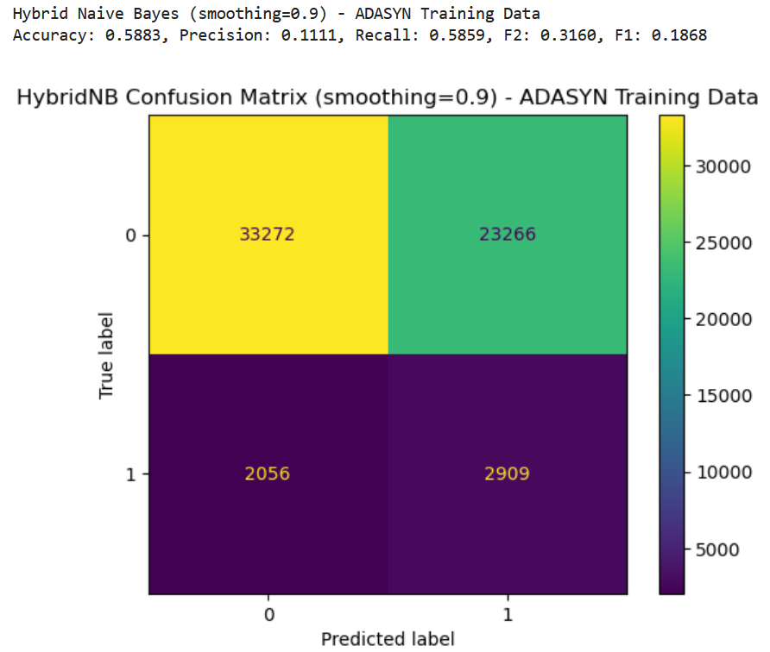
Results
The Gaussian Naive Bayes classifier performed the best in terms of F2 score, but did so because it predicted default a very high percentage of the time, as shown in the confusion matrix on the left
Using a Hybrid Naive Bayes classifier (uses Gaussian Naive Bayes for continuous features and Bernoulli Naive Bayes for binary features) with a larger smoothing parameter achieved a similar F2 score with a much more reasonable distribution of predicted classes, as shown in the confusion matrix on the right

Slide 16
Conclusion
Naive Bayes performs extremely well in terms of recall and has the best F2 scores. It initially did so because of a disproportionately high predicted default rate, but this was improved using hybrid approach and larger smoothing parameter
More complex models that perform better in most circumstances, especially XGBoost struggled
Models trained on SMOTE and ADASYN data performed better in terms of F2 score than those trained on original data, especially pronounced for KNN because SMOTE and ADASYN generate nearby neighbors of the same class
Possible directions for improvement/What could’ve been done differently:
Ordinal encodings for features like education level
More time spent tuning hyperparameters
Examining different classification thresholds
Analysis of feature importances

